Slide 1
TCP/IP Model
James Honeycutt

Slide 2
TCP/IP Model vs. Osi model
OSI Model
TCP/IP Model
Application
Application
Presentation
Session
Transport
Transport
Network
Internet
Data Link
Network Access
Physical

Slide 3
Application Layer
Correlates to the presentation and session layer of the OSI model
Handles session states and application presentations
Protocols
Ssh, http, ftp, smtp
No PDU (Protocol Data Unit) at this layer, its just data
DATA
Header
DATA

Slide 4
Transport Layer
Same as the transport layer in the OSI Model
Responsible for end-to-end connections
Protocols
TCP, UDP
Pdu is a segment
Segment
Header
Segment
Trailer

Slide 5
Internet layer
Correlates with the network layer
It is responsible for logical addressing, path determination and forwarding
Protocols
IP and ICMP
PDU is a packet
Packets
Header
Packets
Trailer

Slide 6
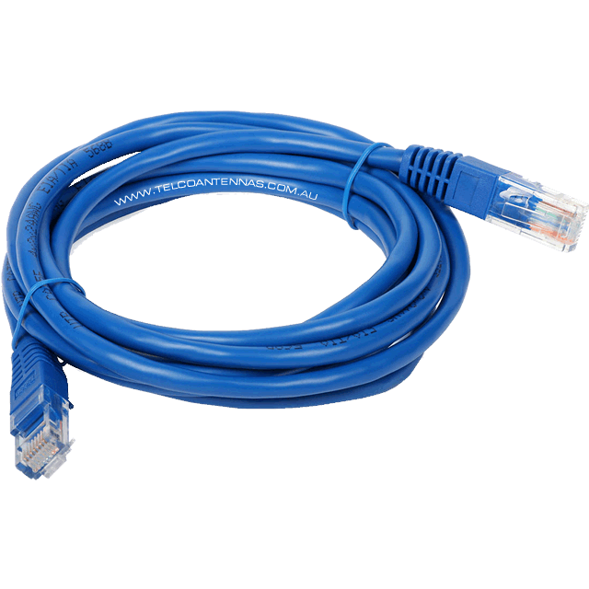
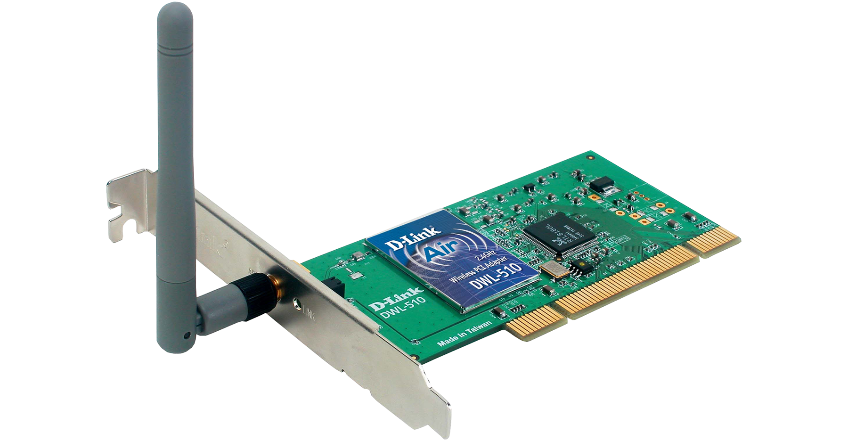
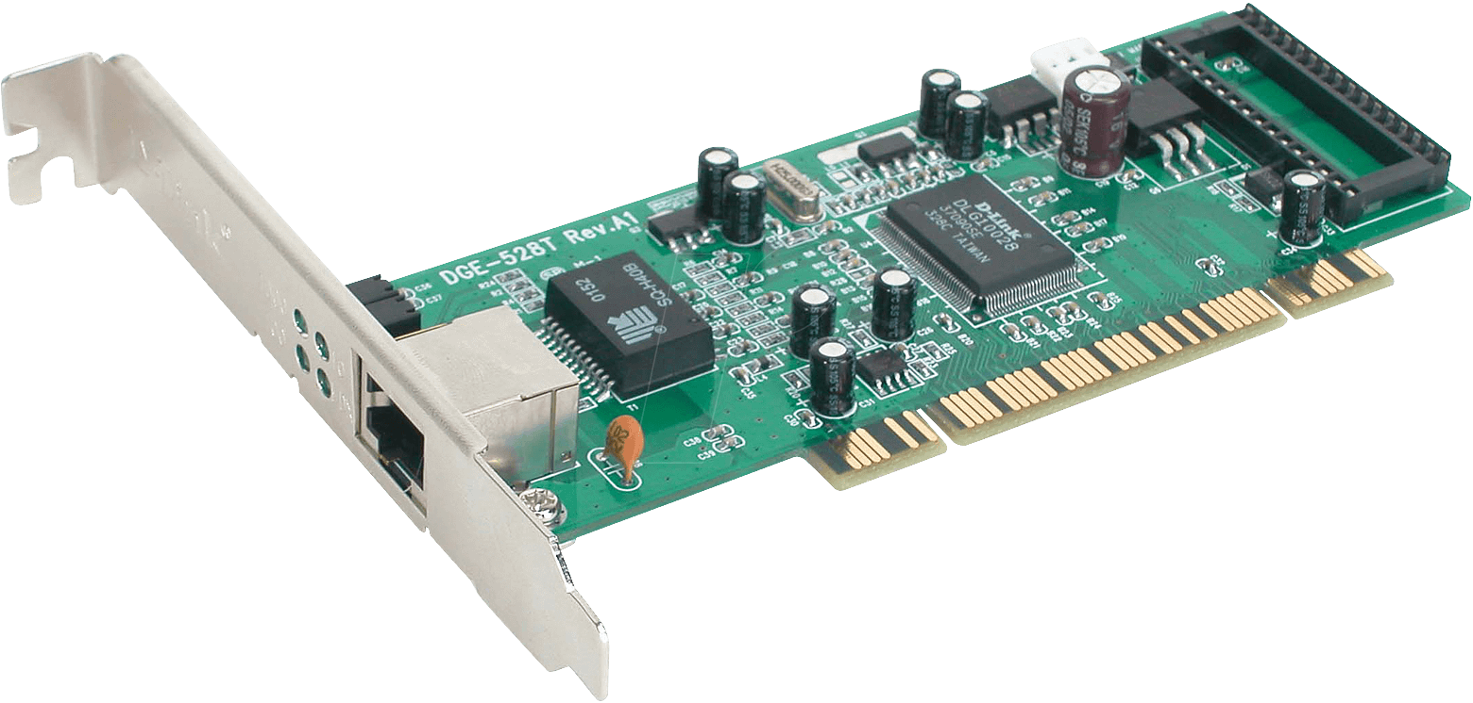
Network access layer
Equivalent to the data link and physical layers of the OSI Model
Used to connect devices to the physical network
Protocols
Ethernet, PPP, Frame Relay
PDU is a Frame

Slide 7
Encapsulation
Application
DATA
Header
Transport
Header
Segment
Trailer
Internet
Packets
Trailer
Header
Network Access
Frame

Slide 8
decapsulation
Application
Header
DATA
Transport
Header
Segment
Trailer
Internet
Packets
Trailer
Header
Network Access
Frame

Slide 9
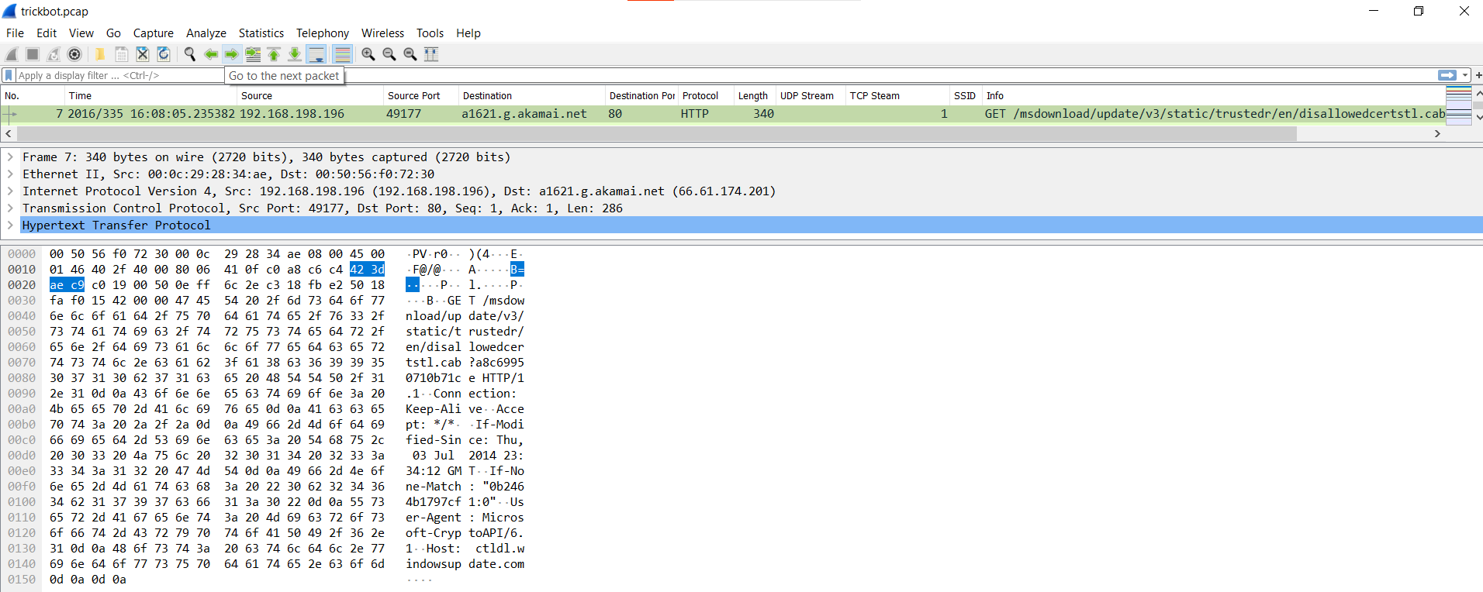
Live Walkthrough

Slide 10
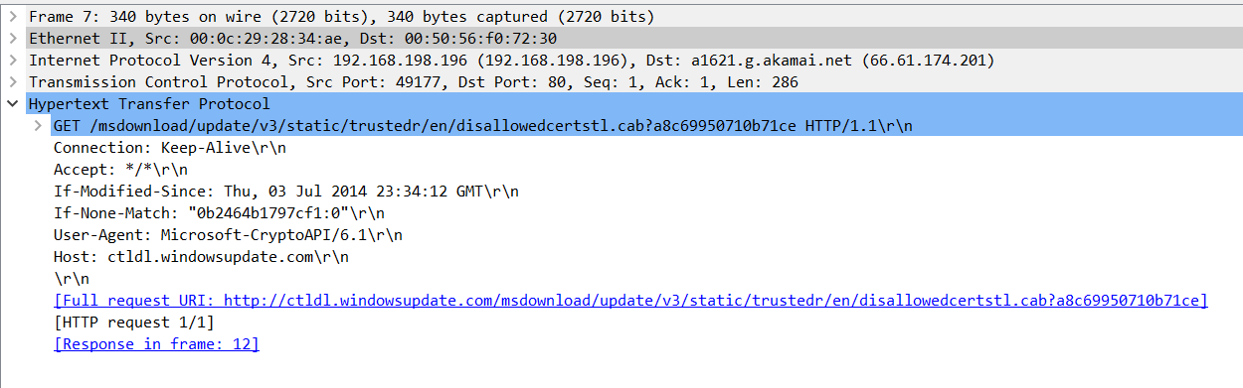
Live walkthrough (cont.)

Slide 11
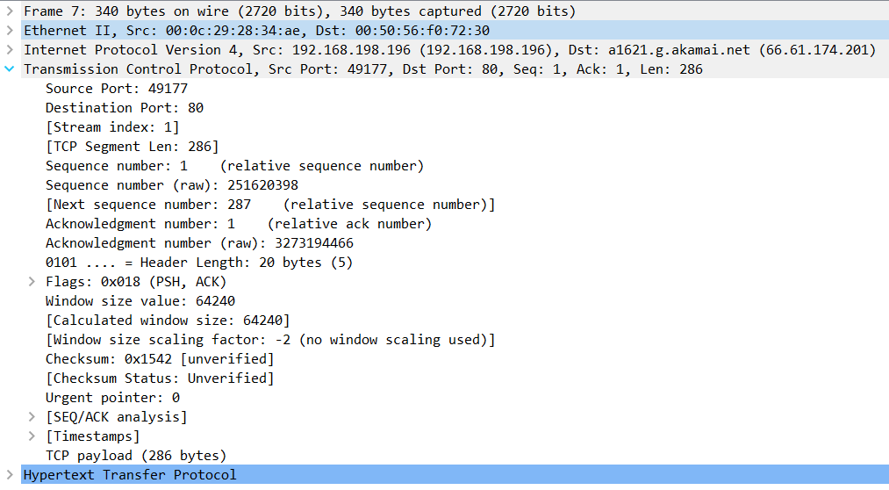
Live walkthrough (cont.)

Slide 12
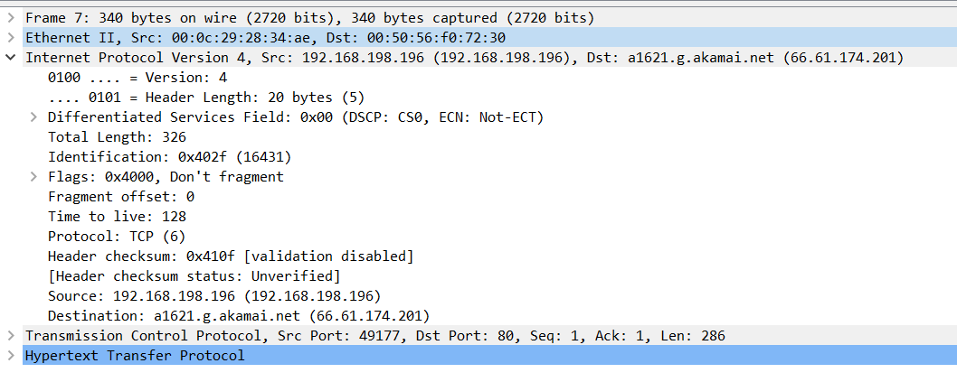
Live walkthrough (cont.)

Slide 13
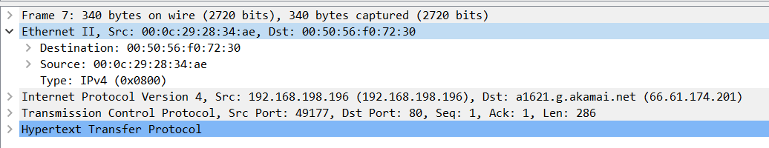
Live walkthrough (cont.)

Slide 14
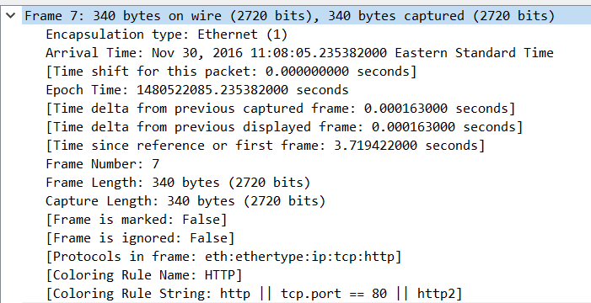
Live walkthrough (cont.)

Slide 15

Questions

